Slide 1
Elementary Talent Development (TD) Program
Highland Creek Elementary
2020-2021
Sept. 28, 2020

Slide 2
What is the mission of CMS’s Elementary Talent Development Program?
To provide appropriate academically and
socially/emotionally intellectual opportunities that
help gifted & high ability learners realize their
potential and connect them with their complex world.

Slide 3
Our Meeting Goals
Explore how the needs of gifted and high-ability learners are met through the Catalyst Model.
Experience snapshots of gifted curriculum and resources and how we are integrating them into instruction at Highland Creek
Review the Differentiated Education Plan/End of Year Review for 2nd-5th graders.

Slide 4
TD Catalyst Teacher Responsibilities
Provides professional development for staff on instructional best practices in gifted education
Models best teaching practices
Utilizes collaboration and consultation skills to implement TD Catalyst Model
Provides assignments, activities, contracts, and other learning opportunities to assist teachers in differentiation curriculum.

Slide 5
So, how does the Catalyst Model Work?
The classroom teacher and Talent Development teacher share responsibility for the education of gifted students.
The TD teacher provides lessons and activities for teachers to use in the heterogeneous classroom AND/OR teachings students directly.
The TD teacher provides enrichment and acceleration for students who have shown mastery of objectives being taught in the regular classroom through direct or indirect instruction.

Slide 6
What are Direct Services?
Direct services, or “face time”, are lessons that are created and taught by the TD teacher
Direct services can be “pull out” (students pulled into TD/Catalyst classroom) or “push in” (students remain with classroom teacher when TD teacher comes in to co-teach with classroom teacher.

Slide 7
What are Indirect Services?
Indirect services are lessons and activities developed by the TD/Catalyst teacher and provided to the classroom teacher for him/her to use in his/her classroom.
Examples are: curriculum compacting, centers, independent contracts, projects, alternative classwork, lessons.

Slide 8
Why the need for direct and indirect services?
Often there are too many students for one person to reach alone. Differentiation is required in the regular classroom to provide all students with the education they need and deserve.
Since the TD teacher cannot see all children, all day, every day, the classroom teacher requires activities and lessons from the TD teacher for those students while they are in the regular classroom.
Without differentiation, everyone would move at the same pace, be evaluated in the same way, and complete the same activities – regardless of their prior knowledge or individual needs.

Slide 9
What is the Catalyst Model?
Joint effort by TD Catalyst Teacher and Classroom Teacher(s)
Allows classroom and TD teacher to design & implement frequent enriching & differentiated educational experiences for gifted and high-ability students
Includes: co-teaching, whole group mini-lessons, small group lessons, individual conferring
Modeling of higher level strategies

Slide 10
Why the Catalyst Model?
Gifted education and general education are related, connected, and integrated.
The pace of learning is enhanced.
High achieving students receive more challenging tasks within the classroom.
Classroom and TD Teachers work together to maximize student learning.

Slide 11
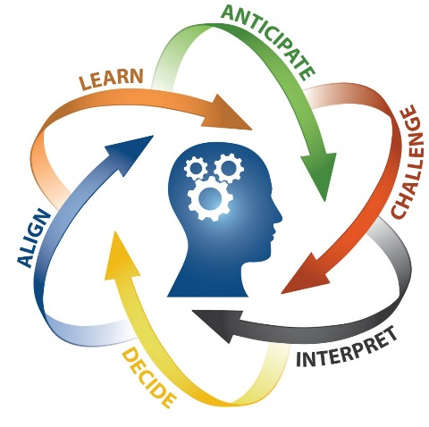
What types of teaching strategies are available for HCE’s gifted students?
Curriculum Compacting
Tiered Lessons
Novel Studies
Socratic and Paidaea Seminars
Learning Centers
Integrated Research Projects
Technology Enhanced Lessons

Slide 12
What are DEPs?
DEPs are Differentiated Education Plans
DEP’s are a document completed annually which lists learning environment, content modifications, and special programs available to the student during that year.
Social and emotional goals are only included as needed.

Slide 13
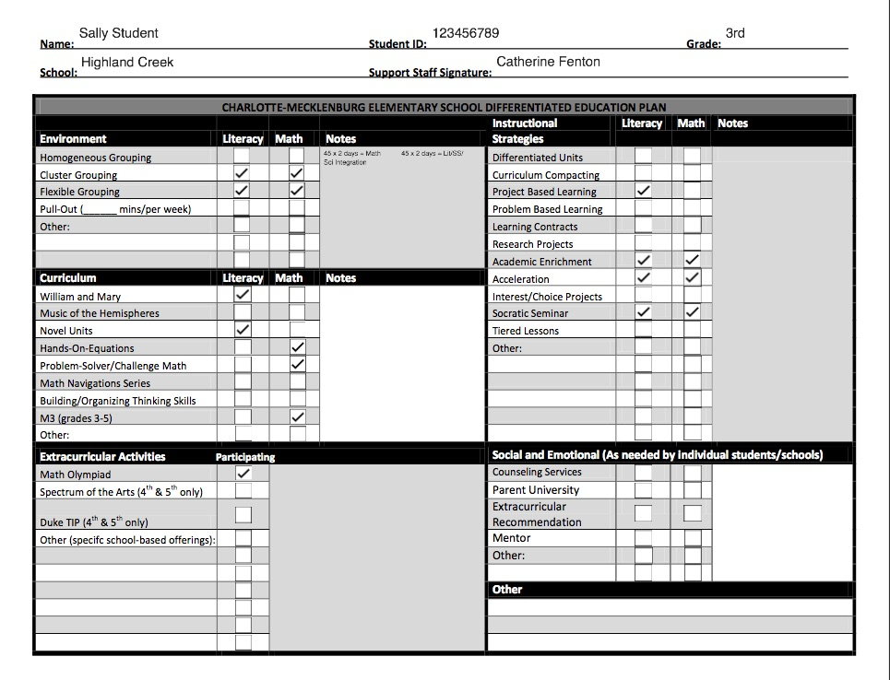

Slide 14
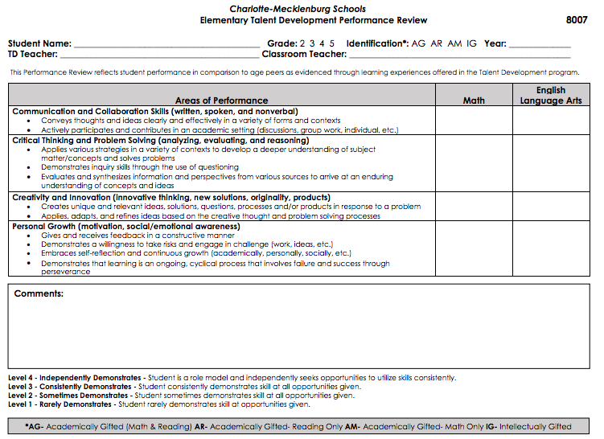
End Of Year Performance Review At the end of each year, each TD certified student in grades 2-5 will receive a TD student performance review rating in addition to their regular report card. Please note: these ratings DO NOT affect the report card grades or class placement.

Slide 15
Lastly....
“I hear and I forget. I see and I remember. I do and I understand.”
~Confucius

Slide 16
What questions do you have for me?
Please don’t hesitate to contact me with questions or concerns related to your child.
catherine.fenton@cms.k12.nc.us
cfenton21.weebly.com

